Slide 1
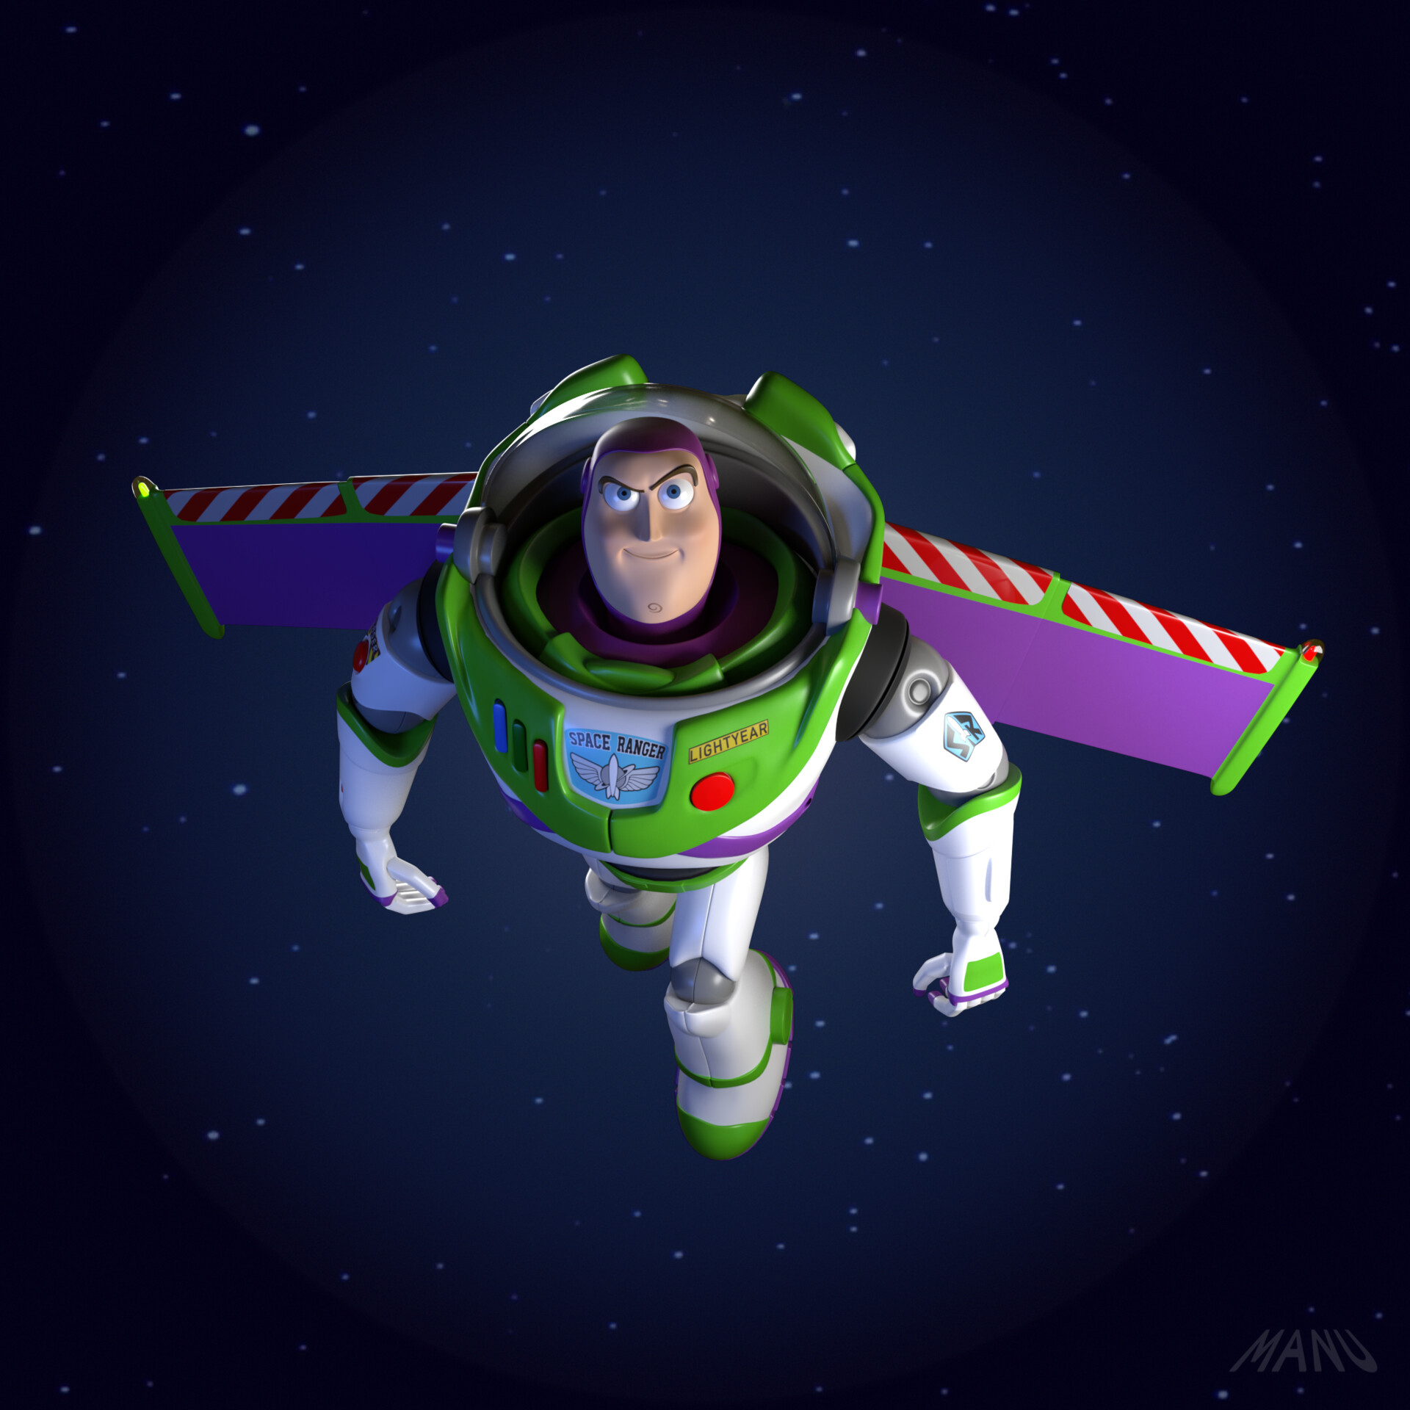
To infinity and beyond

